Slide 1
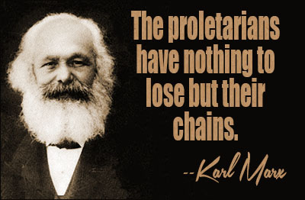
MARXIST THEORY
Notes:
M

Slide 2
MARXIST THEORY
Background
To succeed in America, we must compete against each other for financial success
The “rise to the top” is a virtue
Both religious and educational systems foster the spirit of individual competition and the desire for financial prosperity
Goal
To achieve a worldwide classless society

Slide 3
MARXIST THEORY
To interpret any artistic work, ask
What oppressive socio-economic ideologies influence the characters’ behaviors?
Does the artistic work combat these ideologies?

Slide 4
BASIC CONCEPTS
Classism
Our value as human beings is directly related to the social class to which we belong
Those in the highest class should hold leadership positions

Slide 5
BASIC CONCEPTS
Classism
Marxism considers classism unfair because it grants privileges to a small segment
Marxism considers the acquisition of money is not a sign of merit

Slide 6
BASIC CONCEPTS
Capitalism
Our value as human beings is directly related to the social class to which we belong
Those in the highest class should hold leadership positions

Slide 7
BASIC CONCEPTS
Capitalism
A system in which everything is defined in terms of its worth in money
Marxist Theory suggests that capitalism promotes greed, cultivating the idea that virtue is dependent on making money
Notes:
Marxism is a materialist philosophy, rather than idealist, and is based on fact. It looks at the world as something to be changed. Idealists consider religion or the spiritual world as one that influences or changes.

Slide 8
CAPITALIST IDEOLOGIES
Competition
Needs of the community are overlooked
Commodification
We put an exchange value on people
The American Dream
Many people do not have equal access to education, employment, housing
Rugged Individualism
Puts self-interest before the needs of the community
Religion
Religion acts a kind of drug to keep the poor quiet

