Slide 1
AGENDA
Feminist Theory
Notes:
Wed

Slide 2
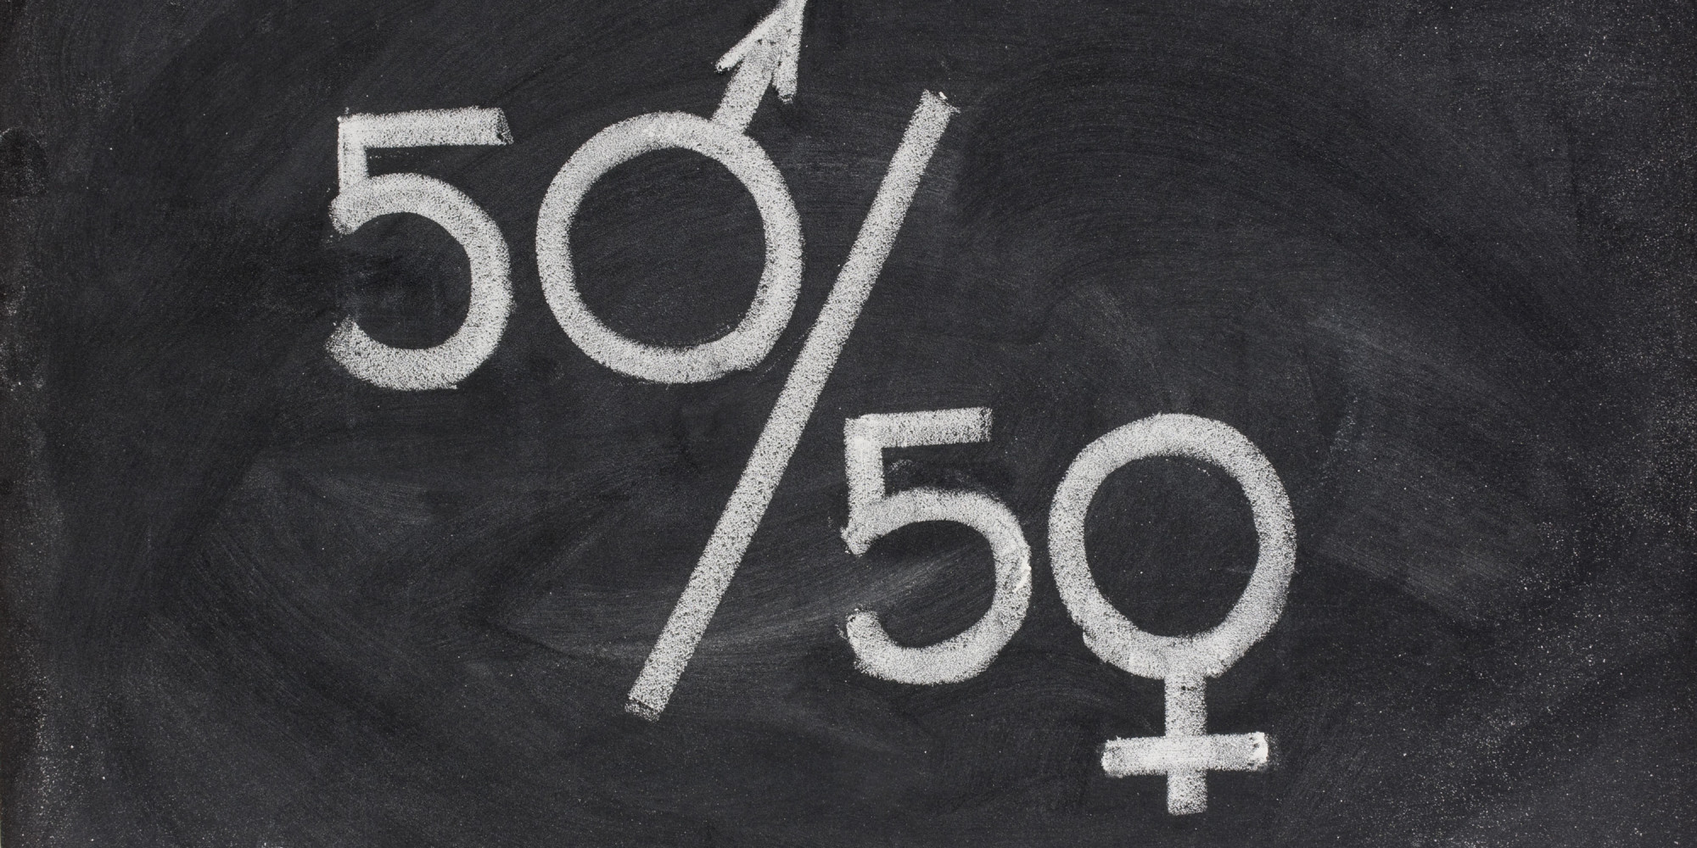
DEFINITIONS
Feminist
Female
Feminine

Slide 3
DEFINITIONS
Feminist political
Female biological
Feminine cultural

Slide 4
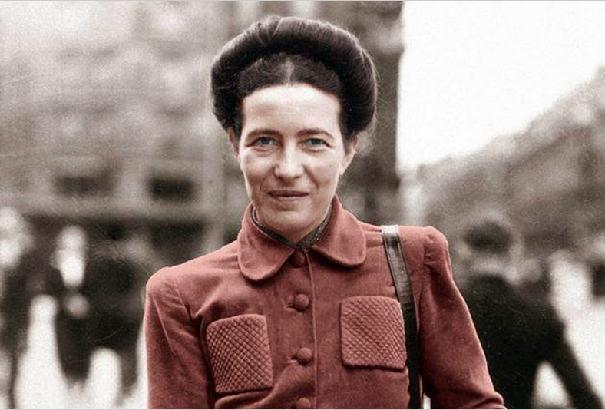
SIMONE DE BEAUVOIR
“One is not born a woman.”

Slide 5
FEMINIST THEORY
Feminist theory asks to examine the way in which our personal identity is formed by our culture’s definitions of what it means to be a man or a woman.
Question:
How were the Macbeths socialized to be “masculine” or “feminine” in their culture?

Slide 6
FEMINIST THEORY PREMISES
Patriarchy
Any society in which men hold all or most of the power
Women suffer varying degrees of oppression (depending on race, ethnicity, socioeconomic class, religion, sexual orientation, home country/region

Slide 7
CONSIDERATIONS
Gender roles produced by patriarchy, rather than by nature
Used to justify inequalities
Good girls (put on pedestals, idealized)
Bad girls (violate traditional roles of sexual conduct)
Both good and bad girls are objectified
Sexism - women are innately inferior

Slide 8
FEMINIST THEORY
Seeks to understand the ways in which women are oppressed

Slide 9
FEMINIST THEORY
Seeks to understand the ways in which women are oppressed
Question:
Write about a section in The Awakening you could analyze using Feminist Theory.

